Slide 1
Chapter 3: Envisioning Architecture
Software Architecture

Slide 2
Introduction to software architecture
What is Software Architecture?
Definitions of Software Architecture
What Does a Software Architect Do?
Architectural structures and views
The Architectural Business Cycle

Slide 3
Architecture
Software architecture refers to the structure of the system, which is composed of various components of a program/ system, the attributes (properties) of those components and the relationship amongst them.
The software architecture enables the software engineers to analyze the software design efficiently.

Slide 4
Cont..
The architecture of a system consists of: the structure(s) of its parts
including design-time, test-time, and run-time hardware and software parts
the externally visible properties of those parts
modules, hardware units
the relationships and constraints between them
Architecture is the fundamental organization of a system, embodied in its components, their relationships to each other and the environment, and the principles governing its design and evolution”. [ANSI/IEEE 1471- 400]

Slide 5
Architecture is:
All about communication
What ‘parts’ are there?
How do the ‘parts’ fit together?
Architecture is not:
About development
About algorithms
About data structures

Slide 6
Architecture is the structure of the components of a program or system, their interrelationships, and the principles and guidelines governing their design and evolution over time
Three fundamental understandings of software architecture.
Every application has an architecture.
Every application has at least one architect.
Architecture is not a phase of development.
Note: Architecture is a design, but every design is not an architecture.

Slide 7
Cont…
A software architecture defines:
The components of the software system
How the components use each other’s functionality and data
How control is managed between the components
Software architecture is the blueprint for a software system’s construction and evolution
Architecture = {components, connectors, constraints}

Slide 8
Components
A software component is an architectural entity that
encapsulates a subset of the system’s functionality and/or data
restricts access to that subset via an explicitly defined interface
has explicitly defined dependencies on its required execution context
Components typically provide application-specific services.
Types of components
computational: does a computation of some sort. E.g. function, filter .
memory: maintains a collection of persistent data. E.g. data base, file system, symbol table.
manager: contains state + operations. State is retained between invocations of operations. E.g. server.
controller: governs time sequence of events. E.g. control module, scheduler

Slide 9
Connectors
A software connector is an architectural building block ,regulating interactions among component.
In many software systems, connectors are usually simple procedure calls or shared data accesses
Much more sophisticated and complex connectors are possible!
Connectors typically provide application-independent interaction facilities.
Types of connectors:
Procedure call connectors
Shared memory connectors
Message passing connectors
Streaming connectors
Distribution connectors
Wrapper/adaptor connectors

Slide 10
What Does a Software Architect Do?
Convert customer requirements into a technical design
Lead the problem domain analysis team
Ensure that the technical design meets quality requirement
Perform continuous risk assessment, develop risk mitigation strategies
Perform early prototyping aimed at mitigation major risks
Communicate with stakeholders through detailed technical presentations
Listen to stakeholders and build consensus
Review developer code and ensure conformance to the architecture and good coding practices
Serve as a mentor for analysts, designers, and developers

Slide 11
Why Is Software Architecture Important?
Architecture is the vehicle for stakeholder communication
Architecture manifests the earliest set of design decisions
The architecture defines constraints on implementation
The architecture dictates organizational structure
The architecture inhibits or enables a system’s quality attributes
Predicting system qualities by studying the architecture

Slide 12
Cont…
The architecture makes it easier to reason about and manage change
The architecture helps in evolutionary prototyping
The architecture enables more accurate cost and schedule estimates
Architecture as a transferable, re-usable model
Software product lines share a common architecture
Systems can be built using large. Externally developed elements

Slide 13
Architectural Design Process
System structuring and partitioning
Decomposition of software system into sub-systems and communications between sub-systems
Sub-system is an independent system from other sub-systems
Decomposition of sub-system into modules or components
Component (module) provides services to other component.
Reuse component

Slide 14
Sub-systems, Modules and Components
A sub-system is a system in its own right whose operation is independent of the services provided by other sub-systems.
A module is a system component that provides services to other components but would not normally be considered as a separate system.
A component is an independently deliverable unit of software that encapsulates its design and implementation and offers interfaces to the out-side, by which it may be composed with other components to form a larger whole.

Slide 15
Architecture Views
View is a manner of looking at something
View is full specification considered from viewpoint
Viewpoint is a direction from something is observed.
View of system is a representation from perspective of viewpoint
Why multi-view? For better understanding and managing
The term “architecture views” rose to prominence in Philippe Krutchen’s 1995 paper on the 4+1 View Model.

Slide 16
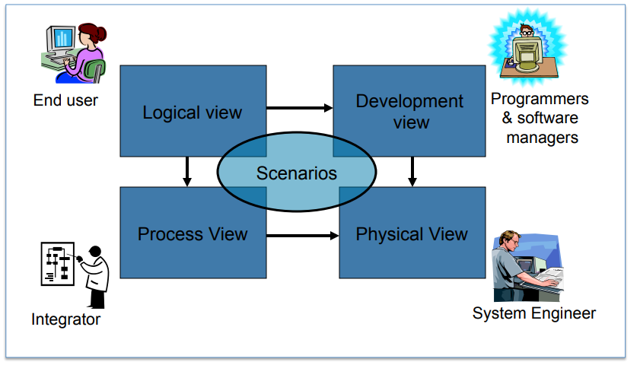
4+1 View Model of Architecture

Slide 17
Logical view
This describes the architecturally significant elements of the architecture and the relationships between them. The logical view focuses mostly on achieving the functional requirements of a system. The logical view essentially captures the structure of the application using class diagrams or equivalents.
Viewer: End-user considers:
Functional requirements- What the system should provide in terms of services to its users.
Notation: The Booch notation (OMT) (object and dynamic models)
Tool: Rational Rose

Slide 18
Process view
This focuses on describing the concurrency and communications elements of an architecture.
The process view focuses on achieving nonfunctional requirements which specify the desired qualities for the system.
In IT applications, the main concerns are describing multi-threaded or replicated components, and the synchronous or asynchronous communication mechanisms used.

Slide 19
Cont…
viewer: Integrators
considers: Non - functional requirements (concurrency, performance, scalability)
Style: Several styles would fit in this view (Garlan and Shaw ‘s Architecture styles)
Uses multiple levels of abstractions, a logical network of processes at the highest level
A process is a grouping of tasks that form an executable unit:
– Major Tasks: Arch. relevant tasks
– Minor Tasks: Helper tasks. (Buffering)

Slide 20
Physical view
This depicts how the major processes and components are mapped on to the applications hardware. It might show, for example, how the database and web servers for an application are distributed across a number of server machines.
Mapping the software to the Hardware
Viewer: System Engineers
Considers: Non-functional req. regarding to underlying hardware (Topology, Communication)
Notation: May have several forms and may Tightly connected to the process view
There may be two architecture:
Test and development
deployment

Slide 21
Development view
This captures the internal organization of the software components, typically as they are held in a development environment or configuration management tool.
For example, the depiction of a nested package and class hierarchy for a Java application would represent the development view of an architecture. Project management is essential in the development view
(Subsystem decomposition)

Slide 22
Cont..
Basis of a line of product
Viewer: Programmers and Software Managers
considers: software module organization (Hierarchy of layers, software management, reuse, constraints of tools)
Style: layered style
Notation: the Booch notation (module, subsystem, layer)

Slide 23
Scenarios
(Putting it all together)
Viewer: All users of other views and Evaluators.
Considers: System consistency, validity
Notation: almost similar to logical view
Tool: Rational Rose
Help illustrate and validate the document
Help Architect during the architecture design

Slide 24
The Architecture Business Cycle
“Software architecture is a result of technical, business, and social influences.
Its existence in turn affects the technical, business, and social environments that subsequently influence future architectures.
We call this cycle of influences, from the environment to the architecture and back to the environment, the Architecture Business Cycle (ABC).”

Slide 25
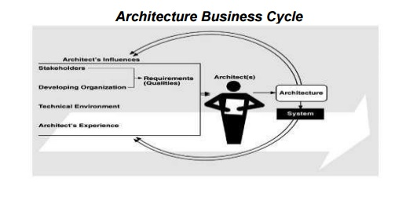
Factors of influence

Slide 26
Three tings required for ABC are
Case studies – of successful architecture crafted to satisfy demanding requirements, so as to help set the technical playing field of the day
Methods – to asses an architecture before any system is built from it, so as to mitigate the risk associated with launching unprecedented design.
Techniques- for incremental architecture –base development, so as to uncover design flaws before it is too late to correct them

Slide 27
Assignment
Review on Architectural Styles
Main Program and Subroutine
Client Server n-Tier
Pipes and Filters
Event Based
Process Control
Layered Systems
Databases
Interpreters and so on

Slide 28

Thank You!

